Slide 1
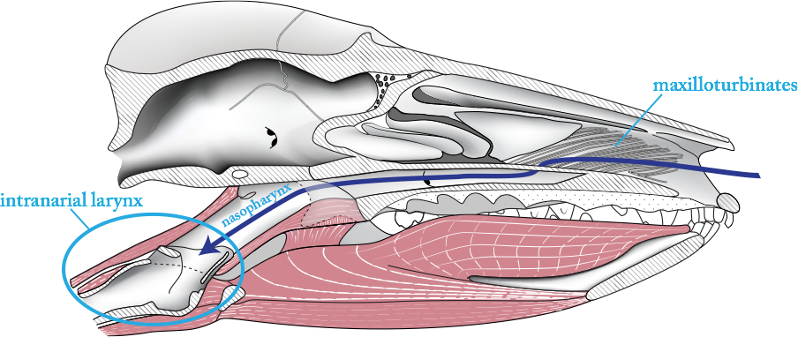



Origin of the pterygoid bone and pharyngeal musculature in mammals
AW Crompton
Catherine Musinsky
Bhart-Anjan Bhullar
Tomasz Owerkowicz

Slide 2
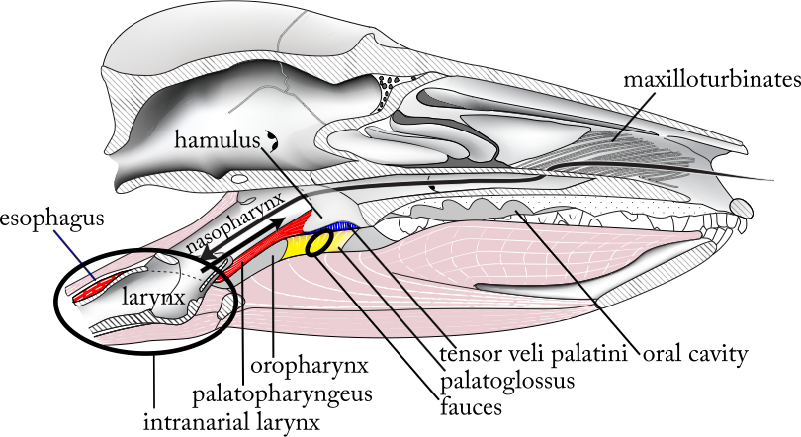

Slide 3
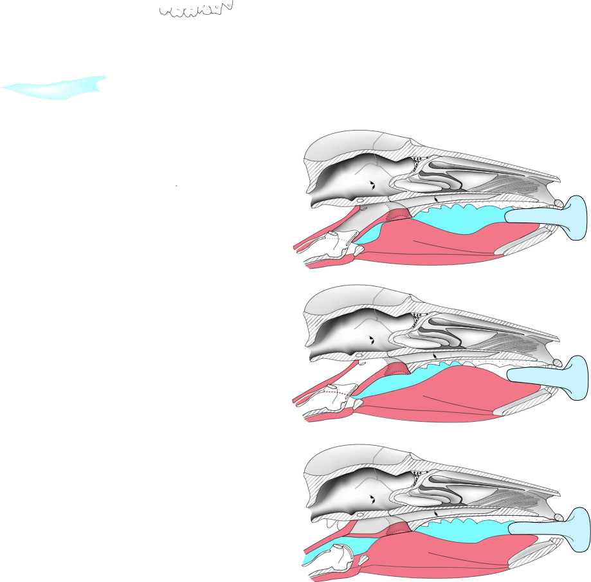


Suckling

Slide 4
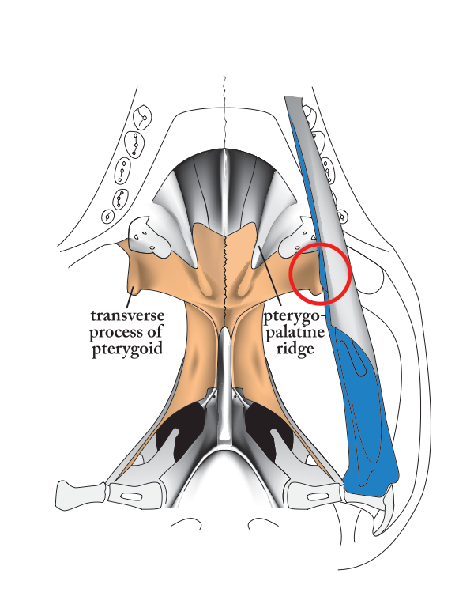
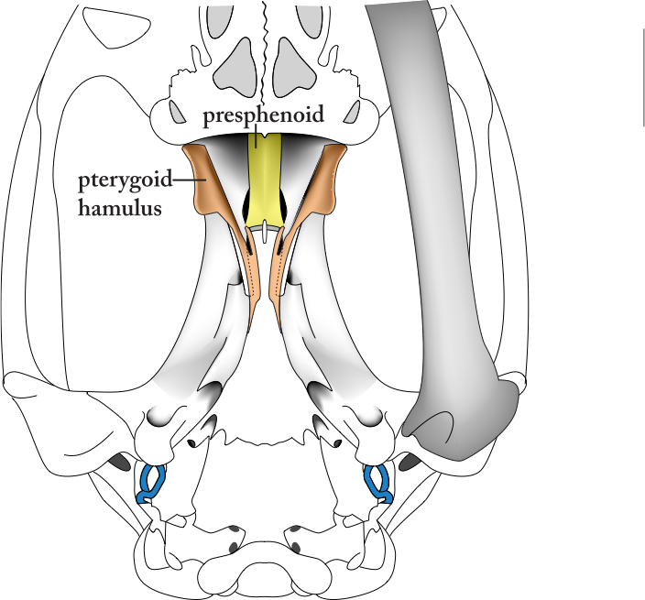
Thrinaxodon
Didelphis

Slide 5
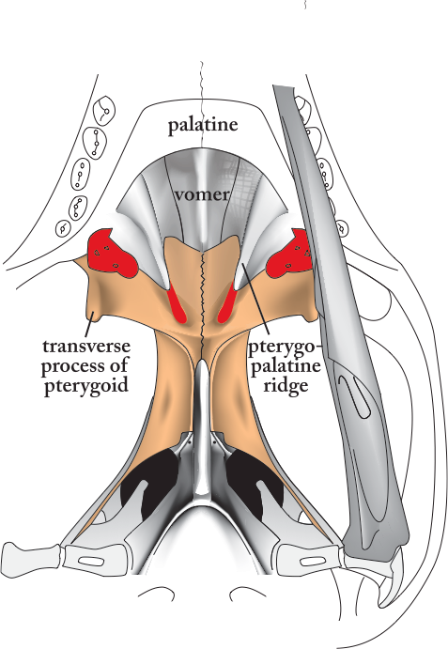
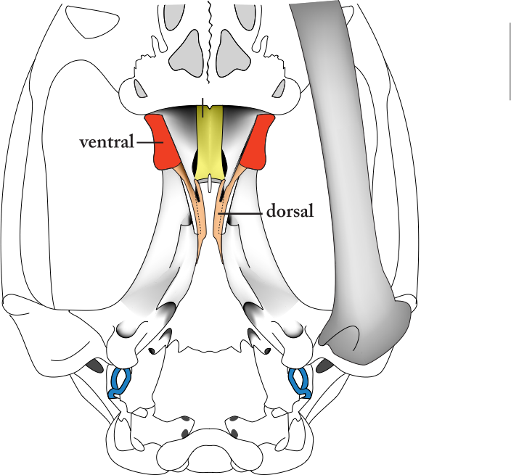
Thrinaxodon
Didelphis
internal
nares

Slide 6
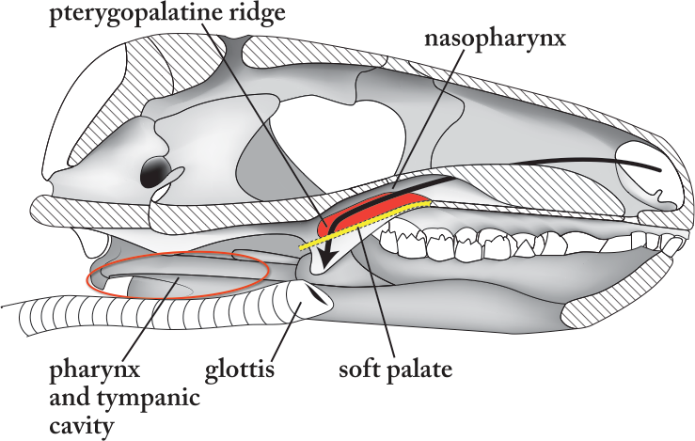
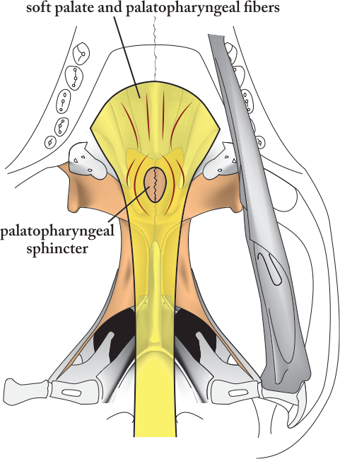
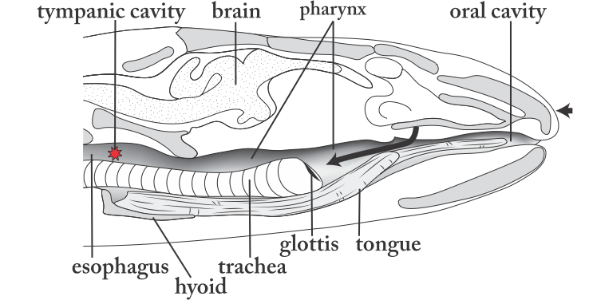
Thrinaxodon
Varanid

Slide 7
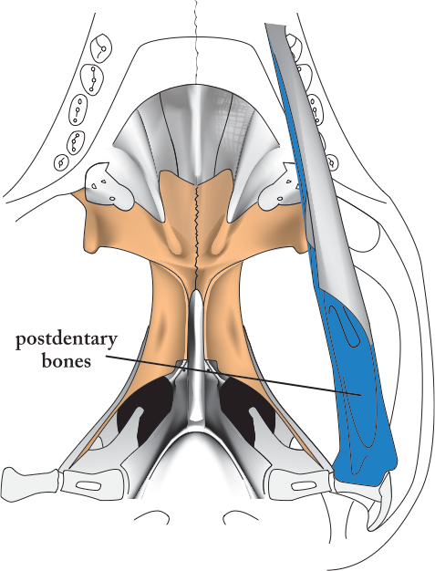
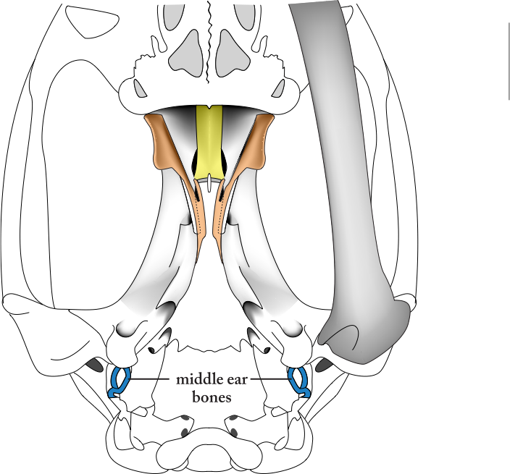
Thrinaxodon
Didelphis

Slide 8
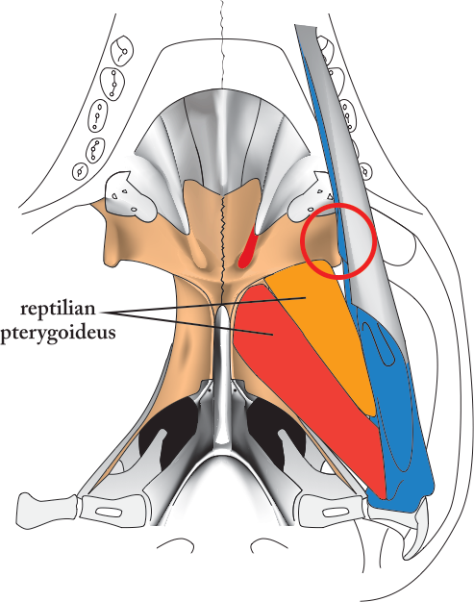
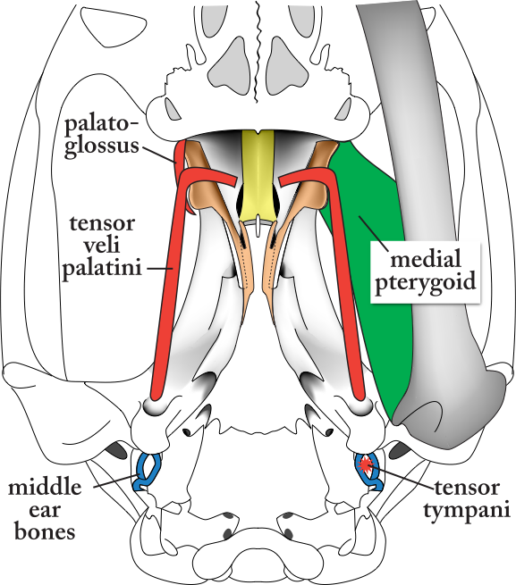
Thrinaxodon
Didelphis

Slide 9
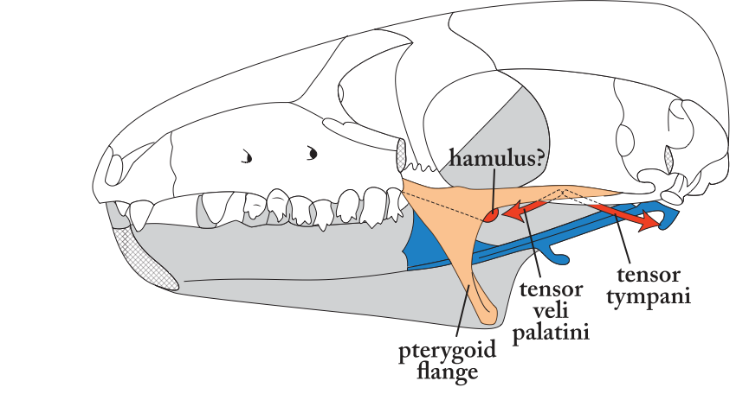
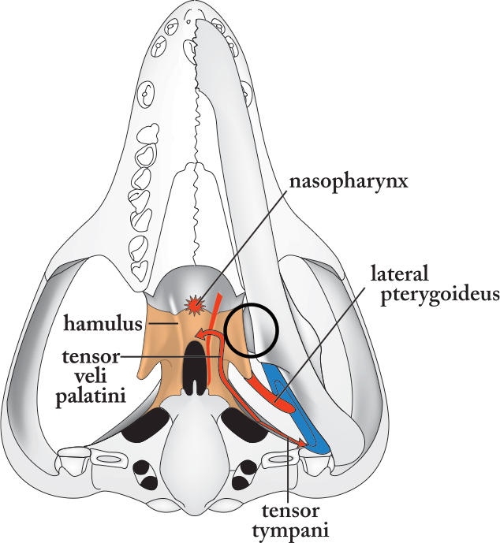
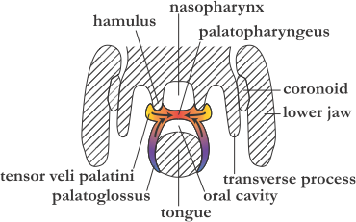
Pachygenelus

Slide 10
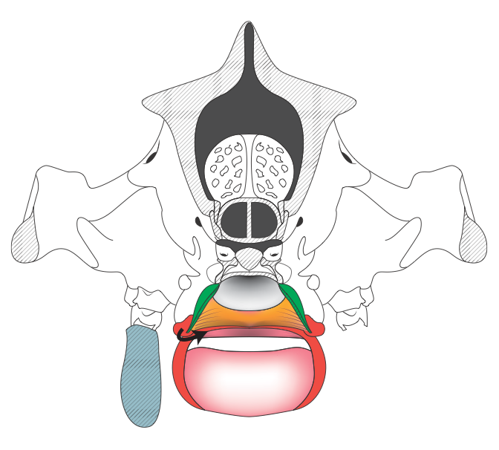
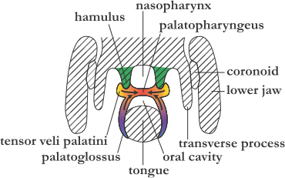
Didelphis
Pachygenelus

Slide 11
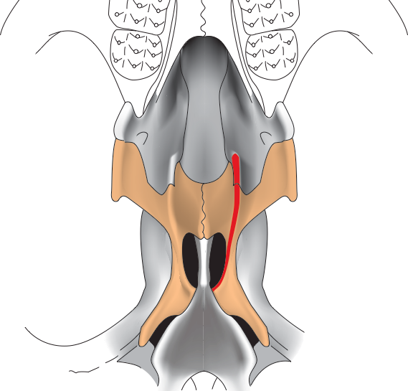
Kayentatherium

Slide 12
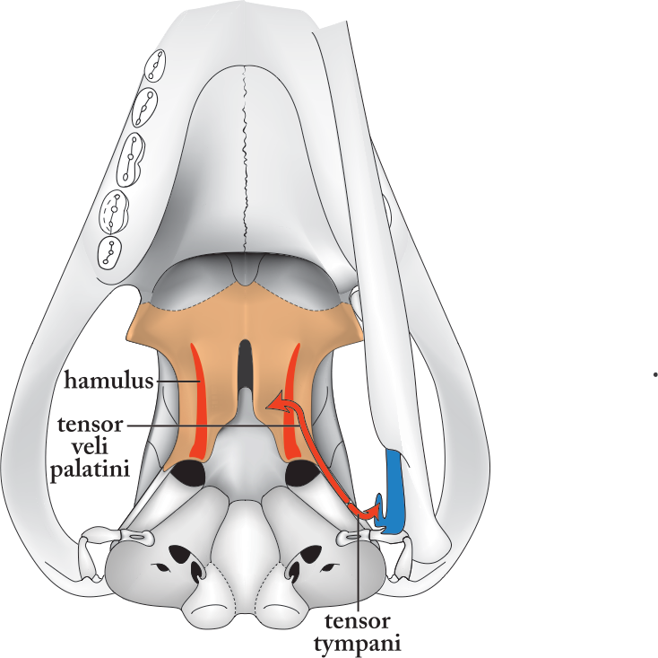
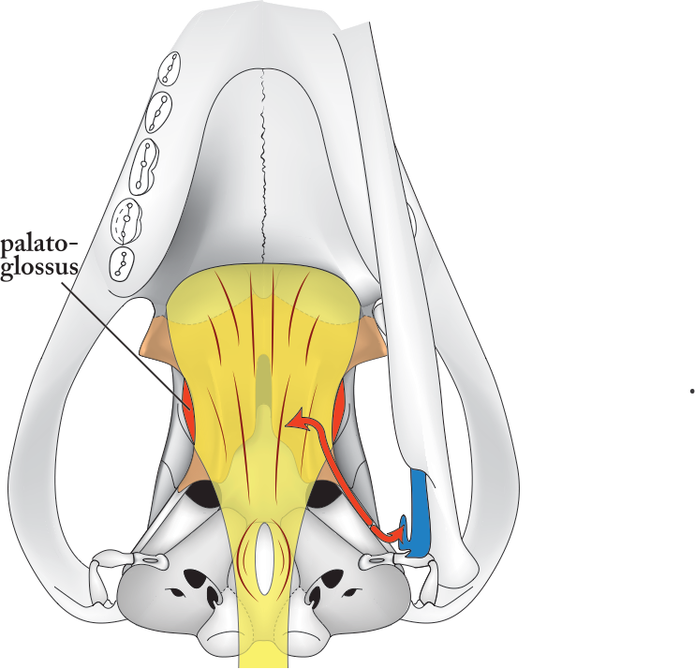
Morganucodon

Slide 13
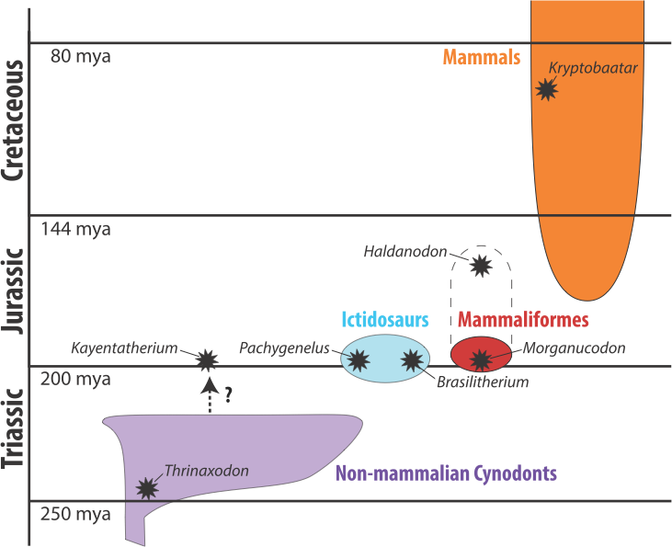

Slide 14
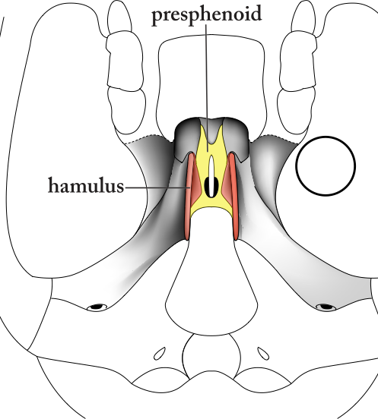
Kryptobaatar
Didelphis

Slide 15

Conclusions
Early Triassic:
  Palatopharyngeal muscle in soft palate
Late Triassic, Early Jurassic:
  Pterygopalatine ridge increased in length and height
  Tensor veli palatini and palatoglossus muscles
  Differential transport of food through the fauces
  Suckling
Middle Jurassic:
  Pterygoid bone reduced, contact with the lower jaw lost
  Ossified respiratory turbinates, intranarial larynx, efficient conservation of heat and water

Slide 16
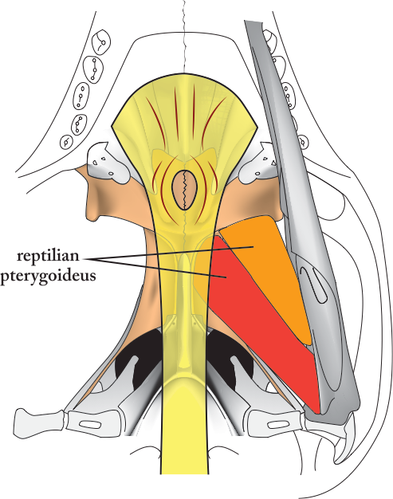
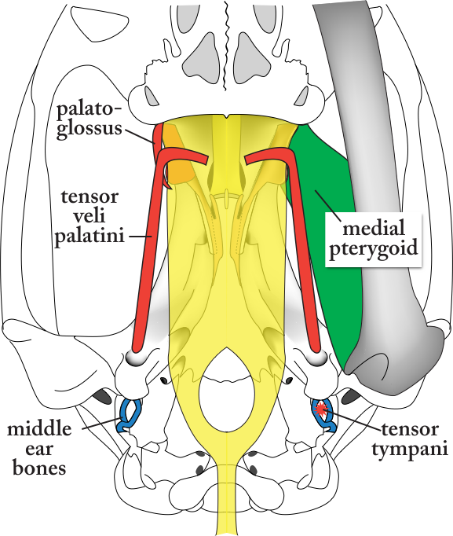
Thrinaxodon
Didelphis

Slide 17
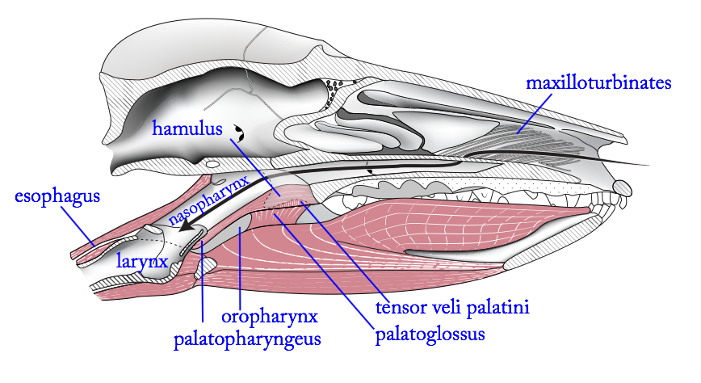
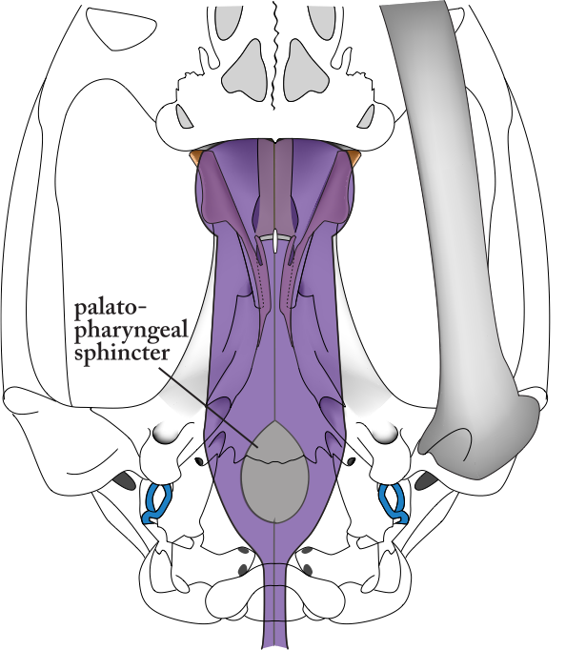
Didelphis
intranarial larynx

Slide 18
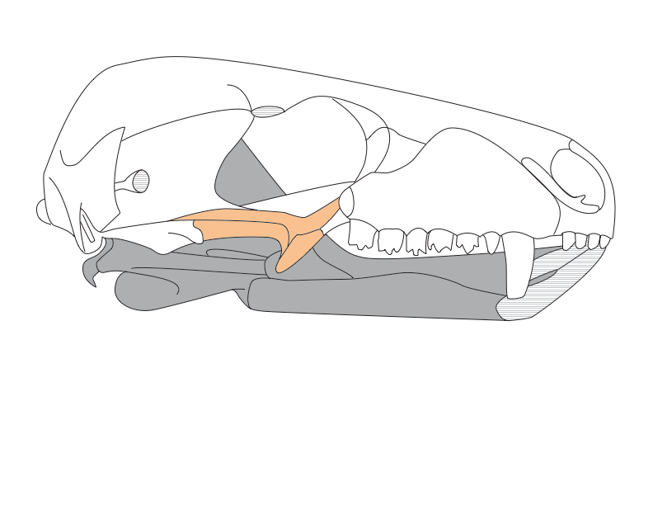
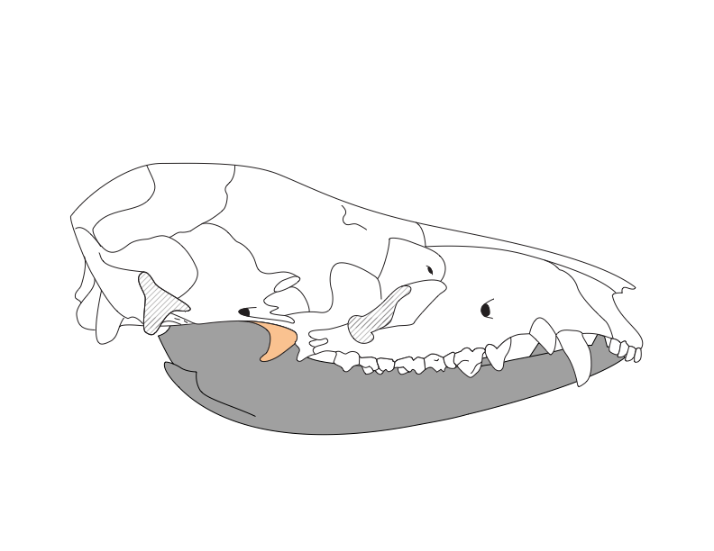
Thrinaxodon
Didelphis

Slide 19
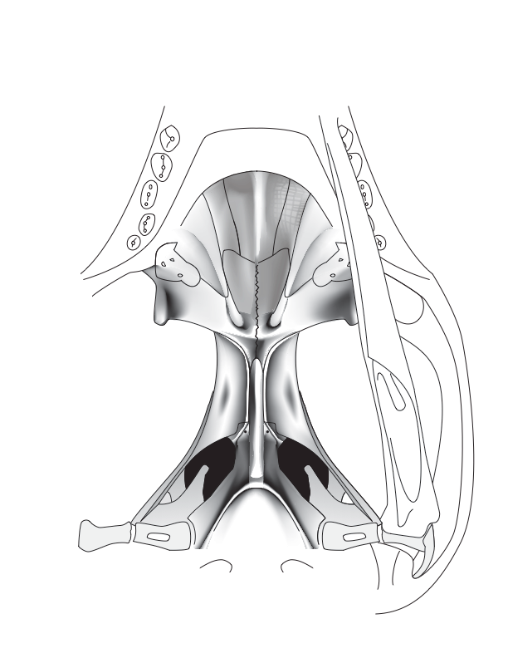
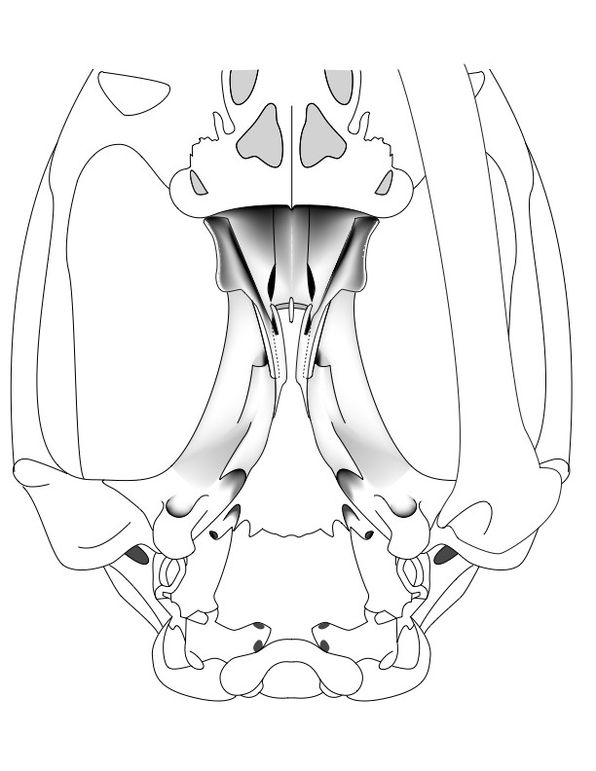
Thrinaxodon
Didelphis

